Slide 1
South Tucson, AZ
Spot Tests
Incremental Development Alliance
Neil Heller, Neighborhood Workshop

Slide 2
Let’s get started.

Slide 3
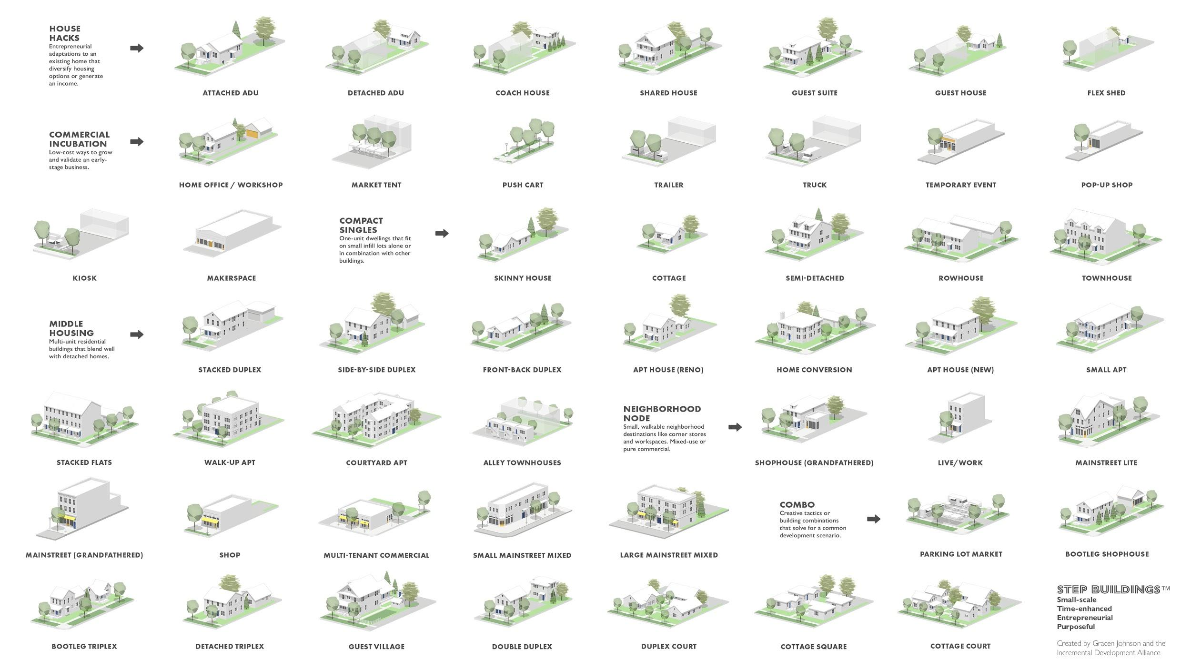
STEP Buildings
Increments of the Neighborhood
Notes:
Here are illustrations of about 50 different building types that respond to various household needs, family arrangements, and income levels.

Slide 4
STEP Buildings
Increments of the Neighborhood
Notes:
Based on our conversations with different working groups and the Project Team, we chose to Spot Test these three unit types in 3 different zones: SR1, SB1, and SB2A.
This next slide will show better.

Slide 5
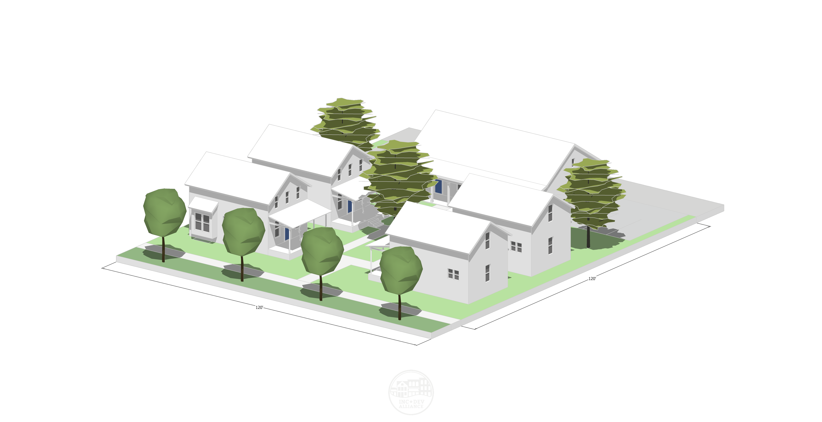
Spot Test - 3 Types
4 Unit House
(Owner-Occupied)
Live-Work ACU
(Accessory Commercial Unit)
Micro Commercial/Condo Village

Slide 6
Four Unit House (STEP example)

Slide 7
Four Unit House Inputs/Outputs
Physical:
4,235 total sf
(4)(900 sf residential)
2 stories (25 feet)
6,486 sf lot
Parked at 1 space per unit
Financial:
Financed Owner-Occupied
(3% over 30 years)
Total Cost: $992,188
Residential: $185 psf
Mo. Rent: $1,499 ($1.67 psf)
Cash-on-Cash Return: 7%

Slide 8
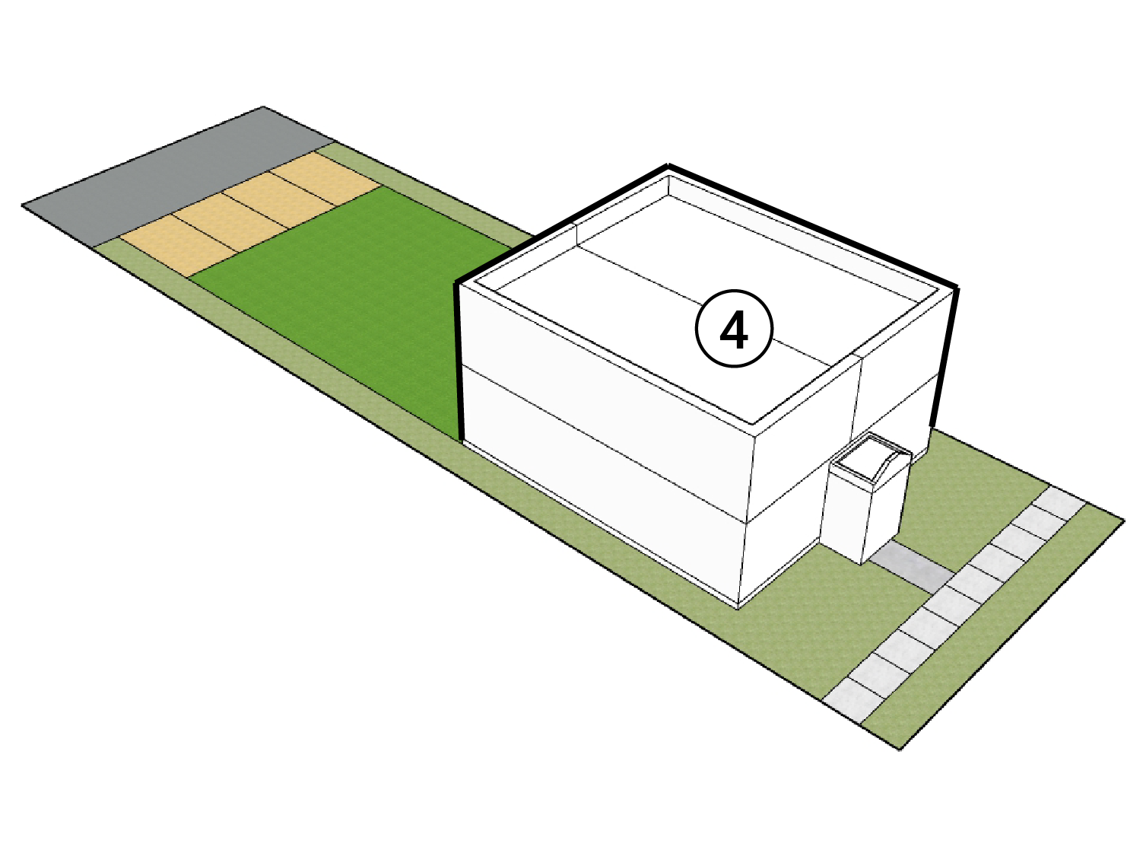
Four Unit House Site Plan
6,486 sf lot zoned SR1 on South 8th Ave
P
4
South 8th Ave
South 8th Ave

Slide 9
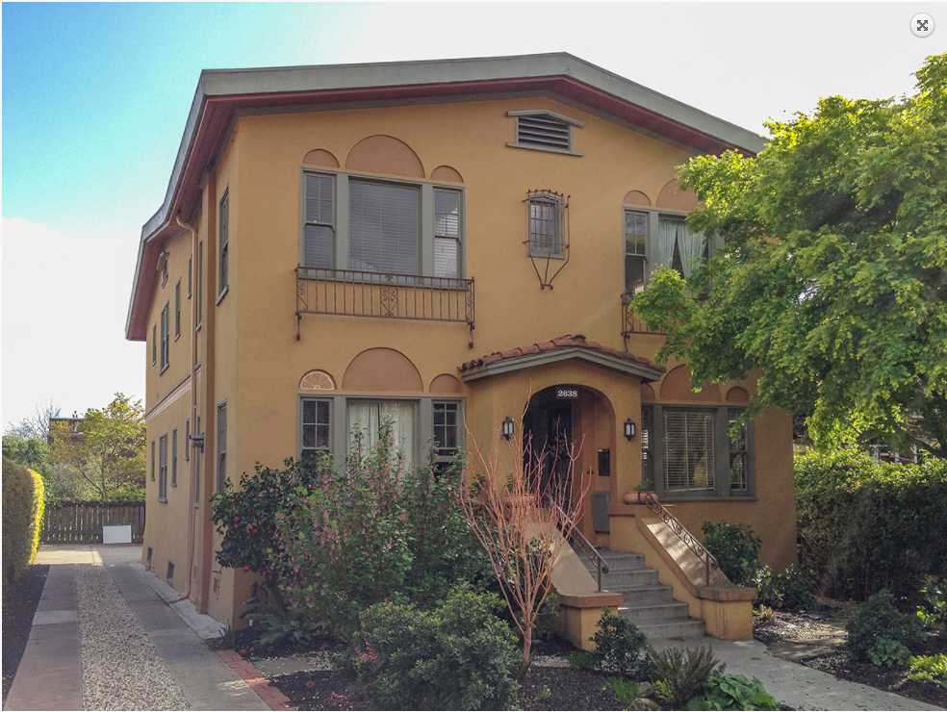
Four Unit House Image
Image via: missingmiddlehousing.com

Slide 10
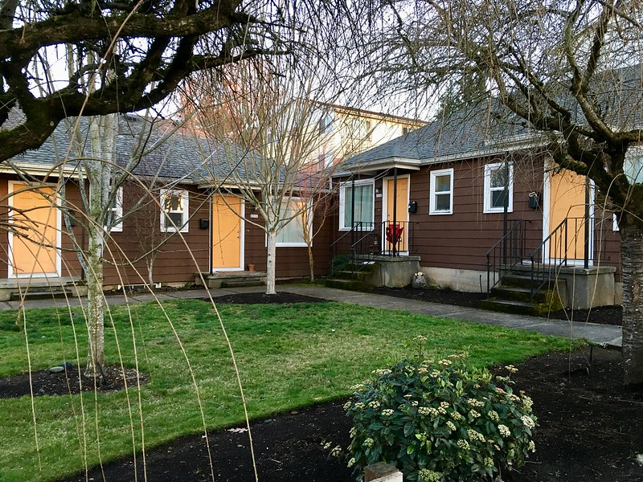
Four Unit House Image
Image via: sightline.org

Slide 11
Four Unit House SR1 Zoning Considerations
Up to four units not currently allowed.
Does not meet minimum lot size.
- would require purchase of additional lot = 2x land costs
If units were bigger, would exceed max lot coverage.
Does not meet minimum side yard setbacks.
Parking is provided at 1 space per unit.
- 2 per unit would require 40% of lot area

Slide 12
Live-Work ACU (STEP example)

Slide 13
Live-Work ACU Input/Outputs
Physical:
5,262 total sf
(4)(900 sf residential)
(2)(500 sf workspace)
2 stories
6,883 sf lot
Parking: 1 per Unit
(none for workspace)
Financial:
Financed owner-occupied
Total Cost: $1,136,972
Residential: $185 psf
Commercial: $125 psf
Residential Mo. Rent: $1,330 Commercial Mo. Rent: $1,000
Res. Cash-on-Cash Return: 7%
Non-Res. Cash-on-Cash Return: 18%

Slide 14
Live-Work ACU Site Plan
6,883 sf lot zoned SB2A on South 6th Ave
P
4
2
South 6th Ave
South 6th Ave

Slide 15
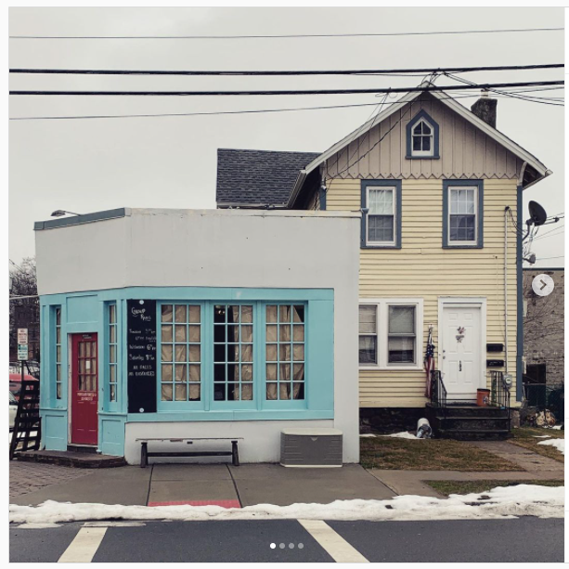
Live-Work ACU Image

Slide 16
Live-Work ACU SB2A Zoning Considerations
Accessory Commercial Unit (ACU) – Allowed?
Does not meet front setback requirements
Does not meet side setbacks
Parking is provided one per residential unit. (Code reqs 5)
None for non-residential workspace

Slide 17
Commercial/Condo Village (STEP example)

Slide 18
Commercial/Condo Village Input/Outputs
Financial:
Commercial Financing
Total Cost: $1,488,148
Residential $185 psf
Retail $125psf
Commercial Mo. Rent: $1,100
Project Return Rate (sale) 18%
Unit Sale Avg: $330k
Commercial Cash-on-Cash Return: 10%
Physical:
7,600 sf
(4) 1-2 story res units
(5) 1-story micro commercial units
7,700 sf lot
Parking required: none

Slide 19
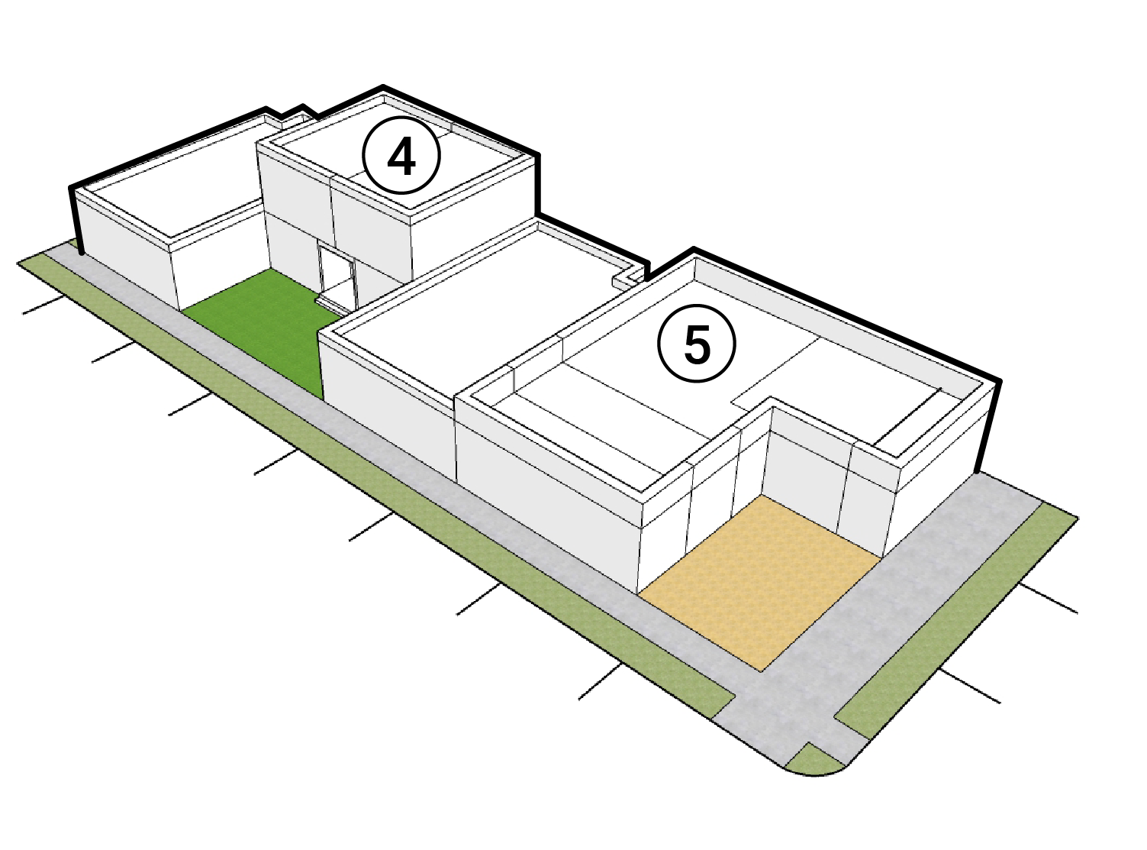
Commercial/Condo Village Image & Site Plan
7,700 sf lot zoned SB1 on West 29th Ave
P
4
5
East 29th Ave
East 29th Ave

Slide 20
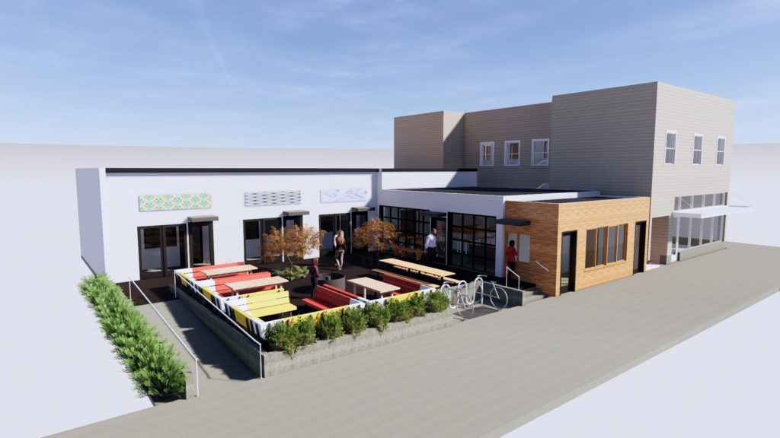
Commercial/Condo Village Image & Site Plan
Image via: gureilladevelopment.com

Slide 21
Commercial/Condo Village SB1 Zoning Considerations
Does not meet minimum front or rear setback requirements.
Parking is provided on-street.
Does not meet minimum building separation requirements.
Others?

Slide 22
Let’s hear your thoughts now.

